Slide 1
"AI-Powered Real-Time Object Detection and Tracking”
:
:
:
PRESENTED BY
DEPARTMENT
COLLEGE
M. Pooja
B. Tech (Artificial Intelligence and Data Science)
G.K.M. College of Engineering and Technology

Slide 2
AGENDA
Introduction & Motivation
Problem Statement
Objectives
System Architecture
Technologies Used
Object Detection (YOLO)
Object Tracking (Deep SORT)
Implementation Workflow
Results & Snapshots
Applications
Challenges & Future Scope
Conclusion & Q&A

Slide 3
Introduction & Motivation
Real-time object tracking is crucial in surveillance, traffic monitoring, and robotics.
Traditional methods face issues like slow detection and ID switching.
This project uses YOLOv5 for fast object detection and Deep SORT for accurate tracking.
Goal: Build a system that detects and tracks multiple objects in real-time with high accuracy.

Slide 4
Problem Statement
In many real-world applications like surveillance, autonomous driving, and smart traffic systems, there is a growing need to detect and track multiple objects in real-time. However, existing solutions often face critical challenges:
Inaccurate object detection under varying conditions
Frequent identity switching during tracking
Poor performance during occlusion or rapid motion
These limitations make it difficult to maintain consistent and reliable object tracking. Therefore, a more efficient system is required that can detect and track multiple objects in real-time, ensuring high accuracy and consistent identity assignment across video frames.

Slide 5
Objectives
Detect multiple objects in real-time using YOLOv5
Track objects across video frames using Deep SORT
Ensure accurate identity assignment with minimal ID switching
Create a robust and scalable system for real-world use
Handle occlusion and fast object movement effectively

Slide 6
System Architecture
Camera / Video Input
YOLOv5 Detection
Deep SORT – Object Tracking
Output Display / Log

Slide 7
Technologies Used
Python – Programming language
YOLOv5 – Real-time object detection
Deep SORT – Object tracking
OpenCV – Video processing
PyTorch – Model implementation
CUDA (GPU) – Faster inference (optional)

Slide 8
Object Detection (YOLO)
YOLOv5 is a state-of-the-art real-time object detection model.
Detects multiple objects in an image with high speed and accuracy.
Processes the entire image in one go – fast and efficient.
Outputs include:
Object class (e.g., person, car)
Confidence score
Bounding box coordinates

Slide 9
Object Tracking (Deep SORT)
Deep SORT stands for Simple Online and Realtime Tracking.
Tracks objects across frames using motion + appearance features.
Assigns a unique ID to each object and maintains it over time.
Handles occlusions, re-identification, and ID consistency effectively.
Works seamlessly with YOLO detections for real-time multi-object tracking.

Slide 10
Implementation Workflow
Capture Video Input
From webcam or video file
Run YOLOv5 on Each Frame
Detect objects and generate bounding boxes
Feed Detections to Deep SORT
Assign unique IDs and track objects across frames
Draw Bounding Boxes & IDs
Visualize results on live video
Display / Save Output
Show real-time tracking or store processed video

Slide 11
Results & Snapshots
Successfully tracked multiple objects (e.g., people, cars) in real-time
Smooth and consistent ID assignment across video frames
Minimal ID switching, even during occlusion and motion
Achieved high accuracy with fast processing speed

Slide 12
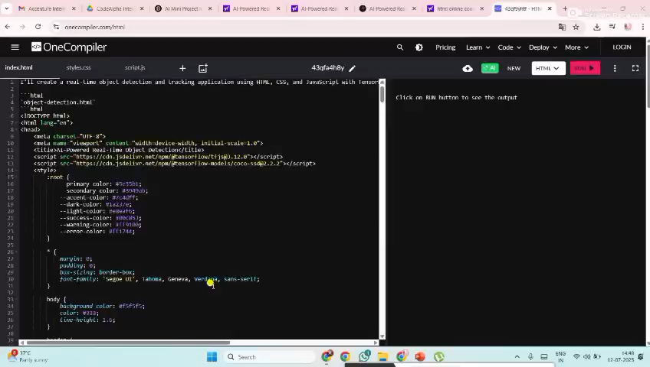

Slide 13
Applications
Smart Surveillance Systems Track people and vehicles in real-time for enhanced security.
Autonomous Vehicles Detect and follow pedestrians, cars, and obstacles on the road.
Retail Analytics Monitor customer movement, heatmaps, and crowd management.
Traffic Monitoring Count and track vehicles to analyze flow and congestion.
Robotics & Drones Enable intelligent navigation using real-time object awareness.

Slide 14
Challenges
Occlusion Handling: Tracking fails when objects are temporarily hidden
ID Switching: Maintaining object identity in crowded scenes is difficult
Resource Constraints: Real-time performance requires powerful GPUs
Fast Motion Blur: Rapid object movement affects detection accuracy

Slide 15
Future Scope
Edge Deployment: Optimize for devices like Jetson Nano & Raspberry Pi
3D Tracking: Integrate depth sensors or LiDAR for spatial tracking
Improved Re-identification: Use stronger appearance models to reduce ID switching
Multi-Camera Tracking: Extend to track across multiple camera views

Slide 16
Conclusion
Successfully developed a real-time object detection and tracking system
Combined YOLOv5 for fast, accurate detection with Deep SORT for reliable tracking
Achieved consistent object identity across frames with minimal ID switching
The system is robust, scalable, and suitable for real-world applications in surveillance, traffic, and robotics

